Slide 1
COMP3002– Advanced Databases
Relations in Database

Slide 2
Facts We Know
• Database is a file, which contains data
• Data is broken into tables
• Tables are broken into columns
• Data is stored in the tables broken into rows, where each row contains information related to each table column
• All columns are represented and treated equally (we can SELECT them, use them in the WHERE clause)

Slide 3
What We might Not Know
Why database is called relational?
What is the meaning of the relationship?
How is it reflected in the database structure?

Slide 4
Relationships
When we think about relationships, we likely think families
Families are connected together by one last name (common factor)

Slide 5
Relations in the Database
Relations in the database are represented by the special columns called keys.
There are two types of keys:
▫ Primary key is a unique identifier, designated for one row in the table
▫ Foreign key is a reference to the unique identifier from the other table (Jones is a foreign key for all family members)
Note: This definition is incomplete and there are more variations of keys (will be discussed later)

Slide 6
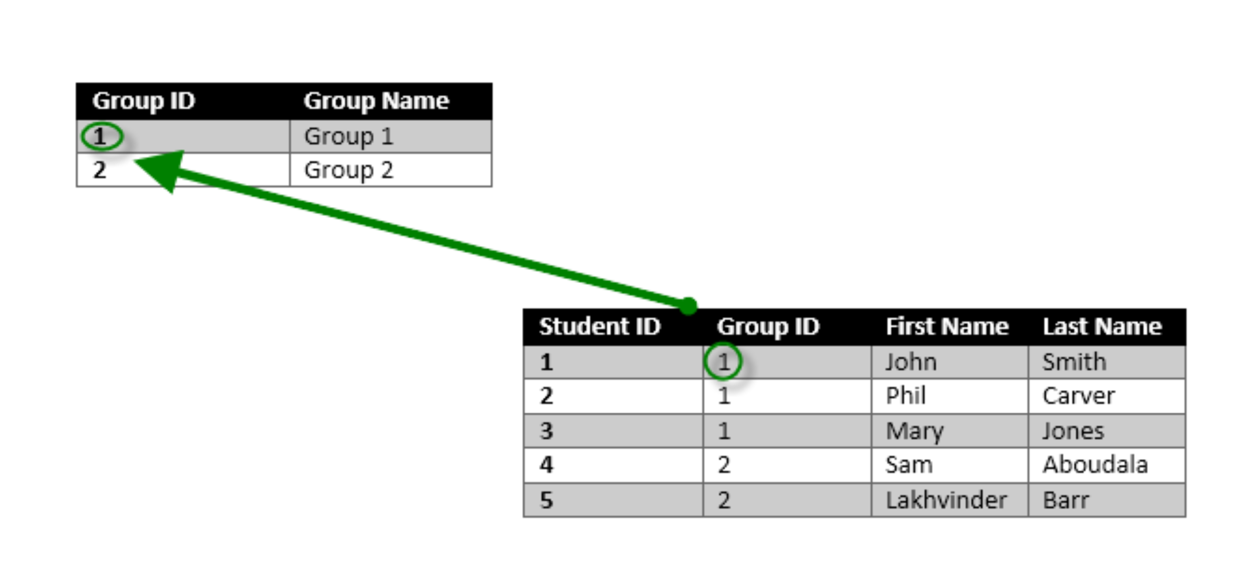
How Relationship Works?
In a well designed relational database all tables have primary keys (unique identifiers).
The table, which has a primary key involved in the relationship is sometimes called Master table (or Parent Table)
The table which contains a reference to a primary key of the other table is sometimes called Detail table (or Child Table).
Zero or more rows in the detail table can refer to the same row in the master table

Slide 7
Problem
The administration wants to see all students ordered by the name of the group.
Student table does not have group names, which must be retrieved from the group table.

Slide 8
Solution (Join)
The requirement is to select data from two tables at the same time by using their relationship.
SELECT groups.[group name], students.[last name],
students.[first name] FROM groups, students
WHERE groups.groupID = students.groupID
ORDER BY groups.[group name]
This join is called simple or inner join.
Implicit syntax for coding inner joins

Slide 9
Using Aliases
By using aliases the query can be rewritten.
SELECT [group name], [last name], [first name]
FROM groups g, students s
WHERE g.groupID = s.groupID
ORDER BY [group name]
Important rule: if the column name is unique, the alias (table) prefix is NOT required.

Slide 10
Results of the Query
Group Name | First Name | Last Name
Group 1 | John | Smith
Group 1 | Phil | Carver
Group 1 | Mary | Jones
Group 2 | Sam | Aboudala
Group 2 | Lakhvinder | Barr

Slide 11
Explicit Join
SELECT groups.[group name], students.[last name],
students.[first name]
FROM groups INNER JOIN students
ON groups.groupID = students.groupID
ORDER BY groups.[group name]
Same query of slide #8
Explicit syntax for coding inner joins

